Slide 1
BRASS Scenario 2
Mission Suddenly Requires to Change Frequency of Operation
F-22 Coating Upgrades
Adapted from a flight test that occurred in 2005

Slide 2
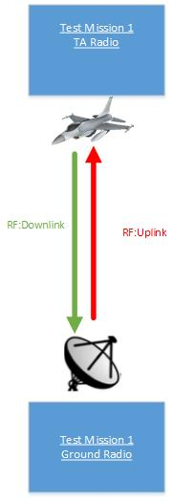
Scenario #2 – Brief Description
A fighter is operating at an assigned frequency. Testing is interrupted when another higher priority mission needs to use the same frequency. To accommodate the higher priority mission, the assets associated with the fighter must be reconfigured immediately at a newly assigned frequency.

Slide 3
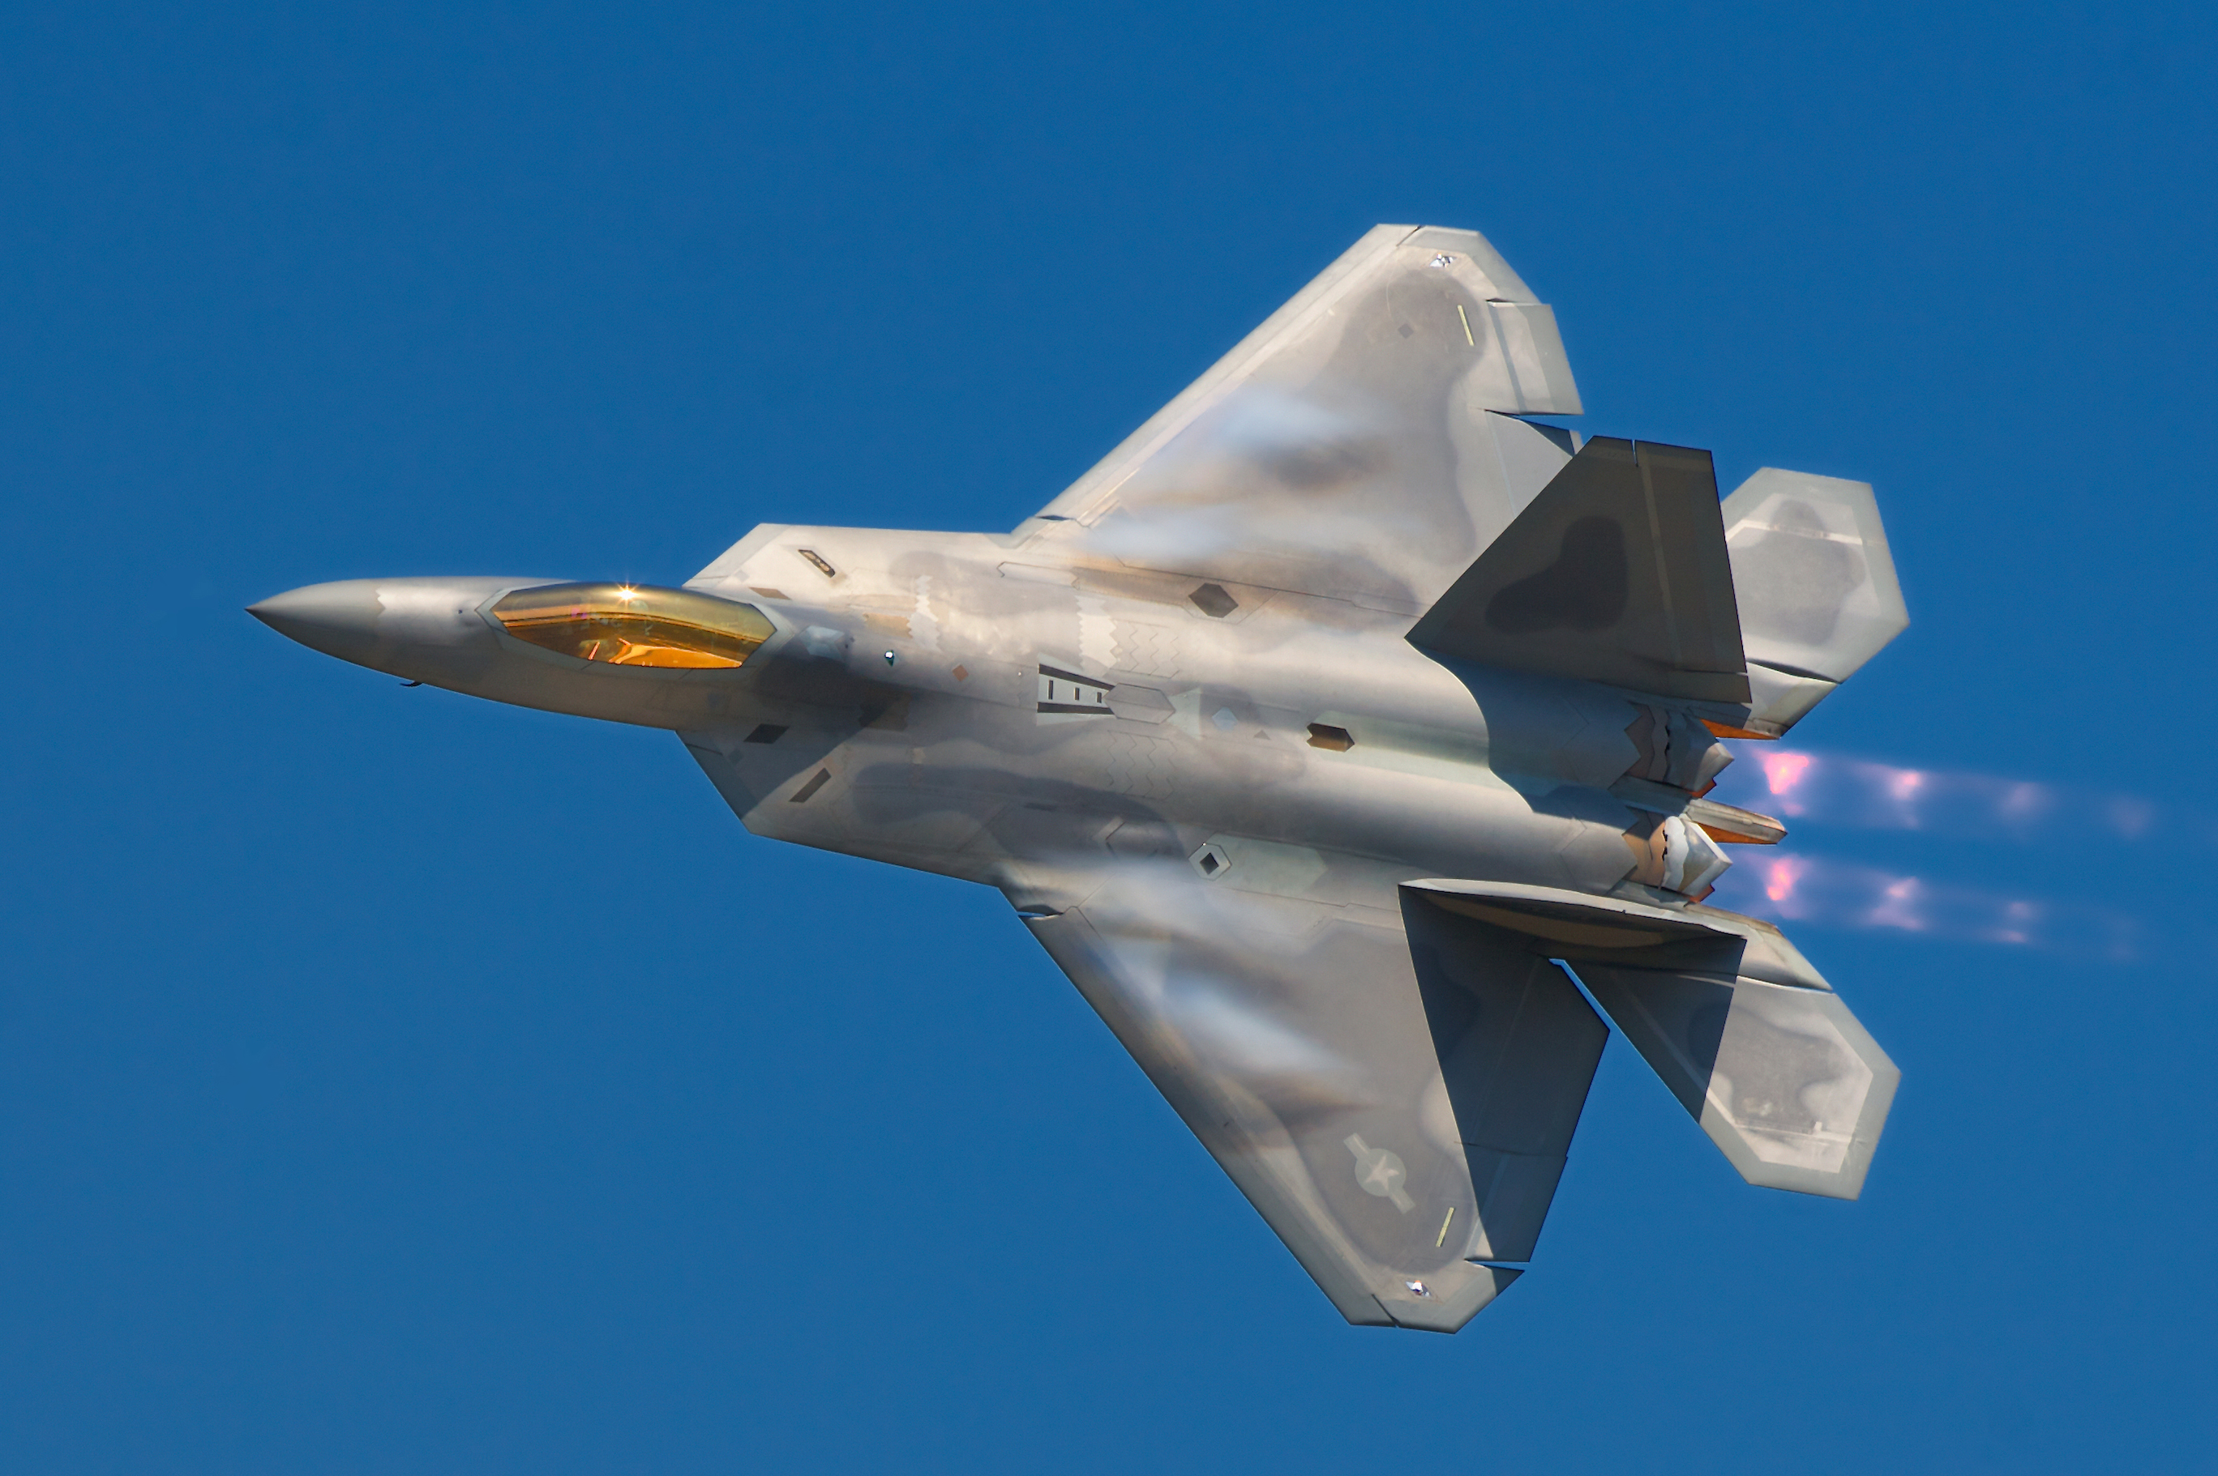
Test Article
Aircraft: F-22 Raptor

Slide 4
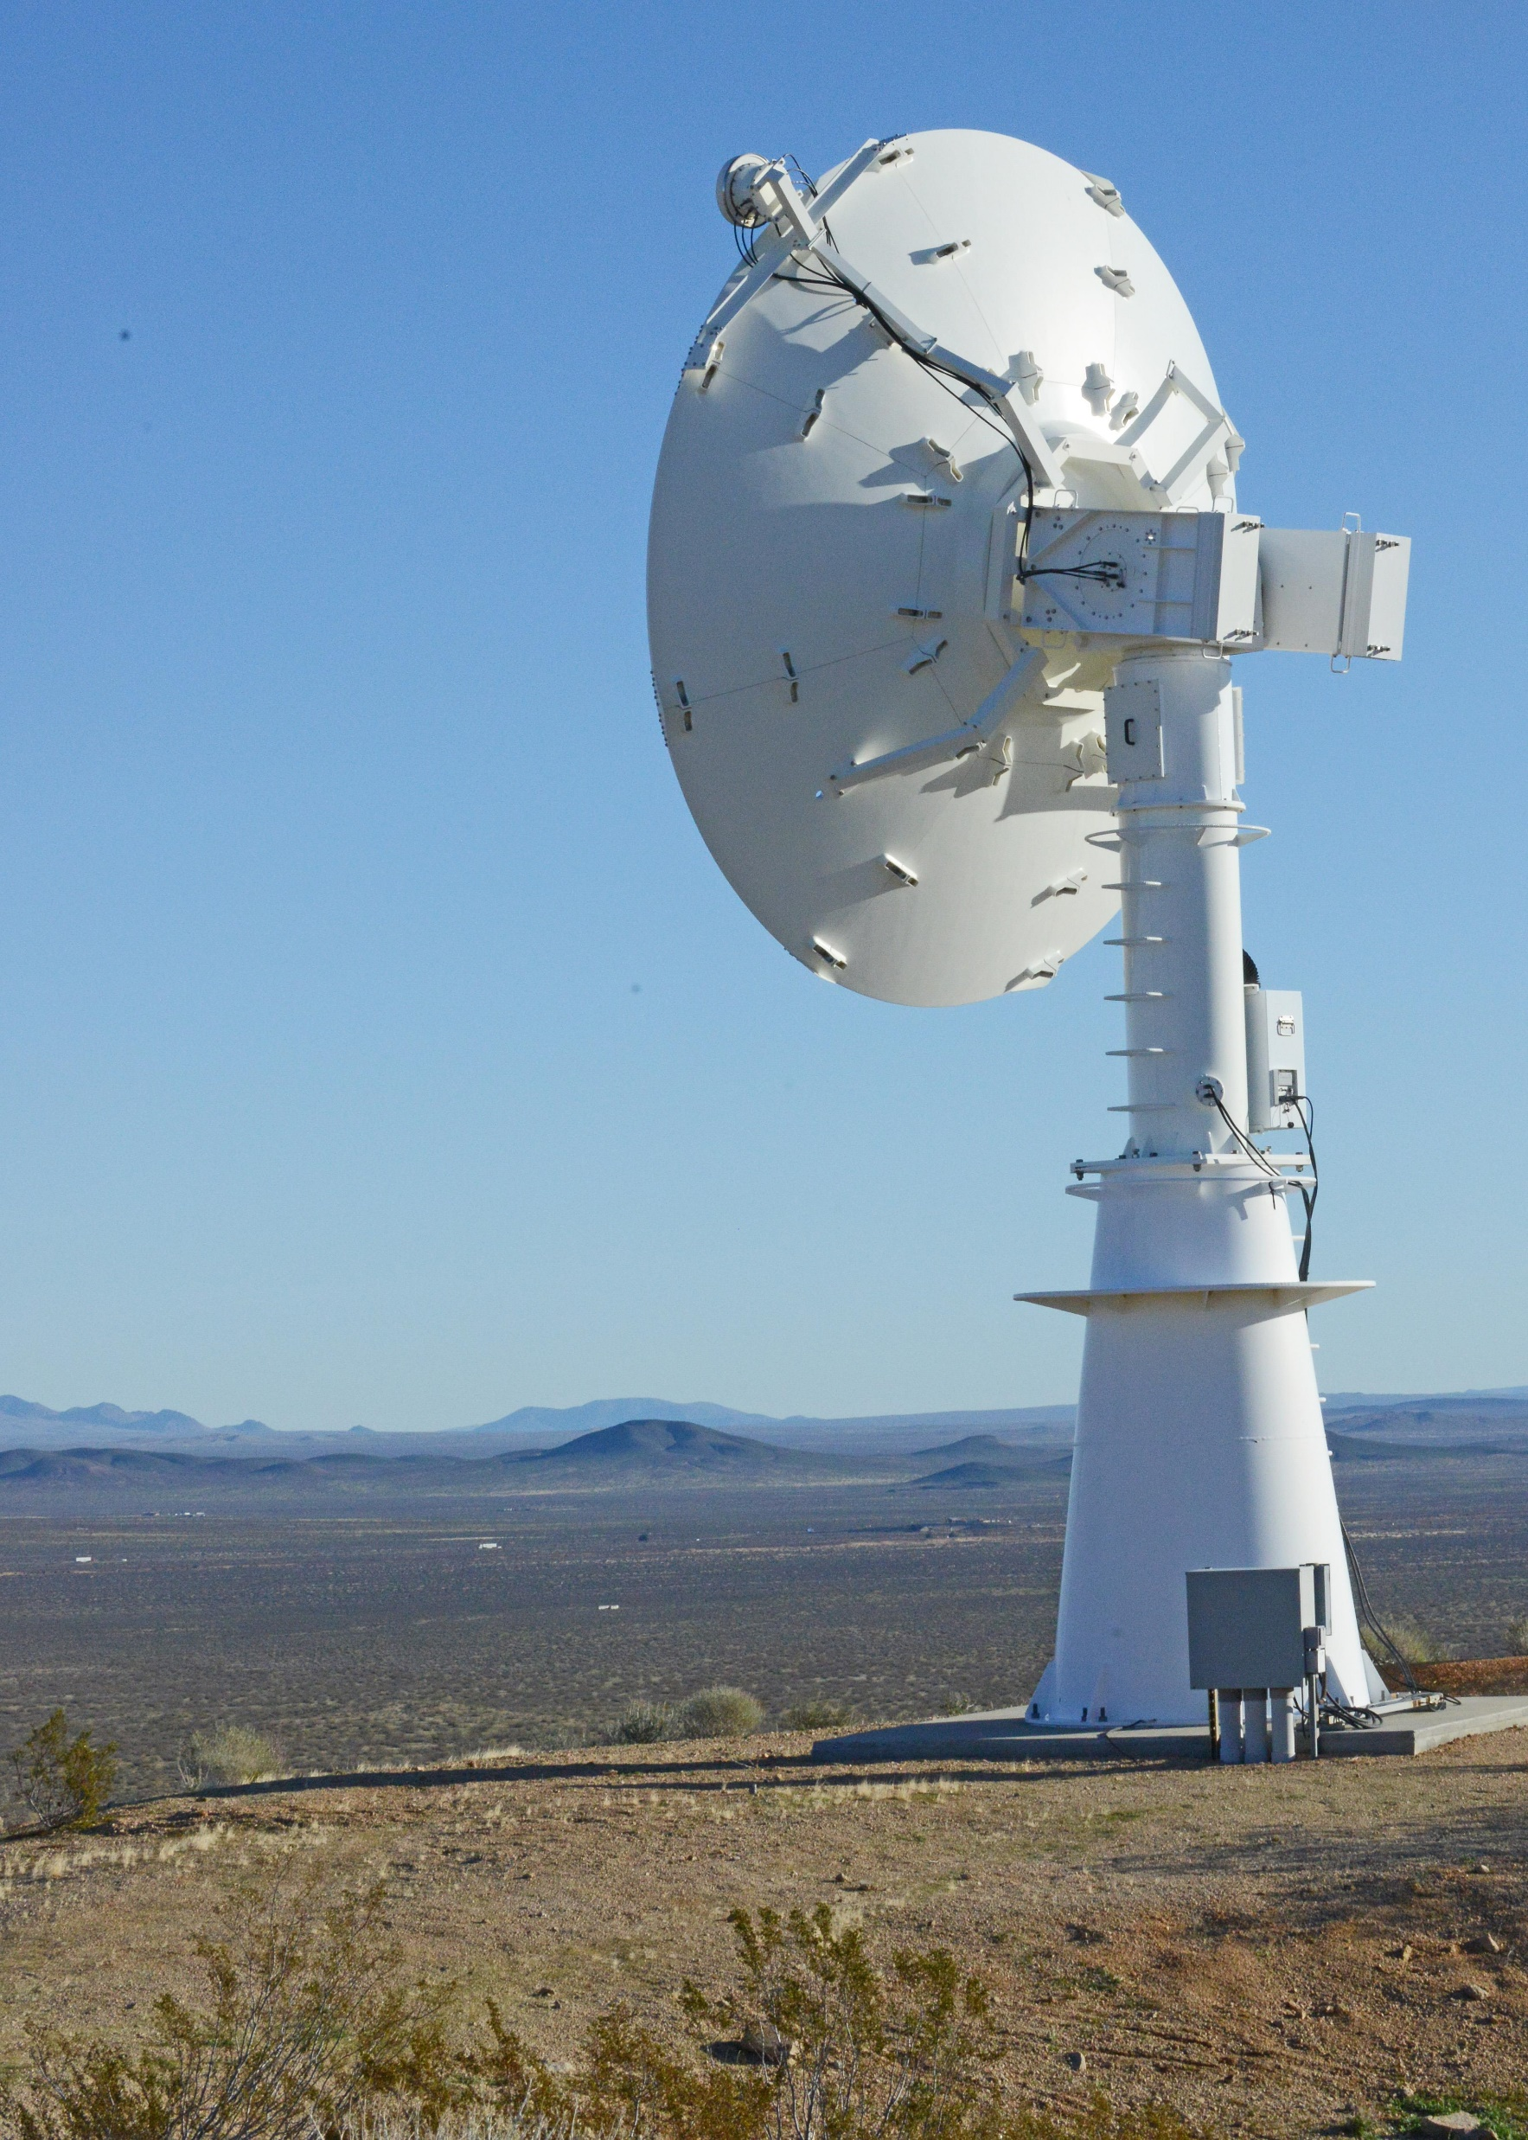
Range Infrastructure
Range Network: Typical large military range e.g. Edwards Air Force Flight Test Center
Equipment Used:
Ground Station Tracking Antenna and related network infrastructure
MCR processing live data
Equipment Available:
All in use

Slide 5
Flight Test Operation Flow

Slide 6
Associated Constraints
Physical limit on amount of bandwidth that can be achieved on one frequency

Slide 7
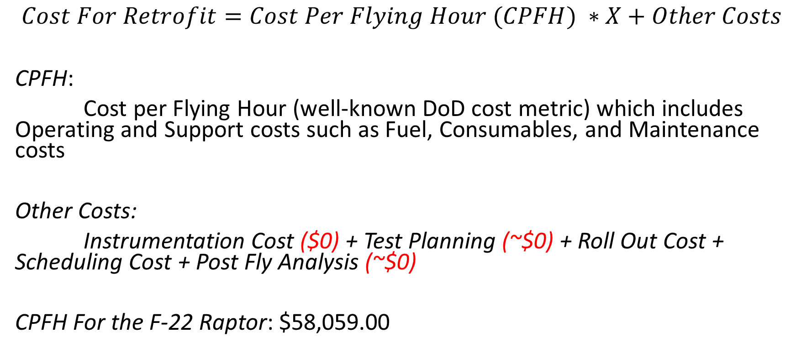
Cost Metrics
$$Cost For Retrofit=Cost Per Flying Hour (CPFH) ∗X+Other Costs$$
CPFH:
Cost per Flying Hour (well-known DoD cost metric) which includes Operating and Support costs such as Fuel, Consumables, and Maintenance costs
Other Costs:
Instrumentation Cost ($0) + Test Planning (~$0) + Roll Out Cost + Scheduling Cost + Post Fly Analysis (~$0)
CPFH For the F-22 Raptor: $58,059.00
Assumptions:
(1) Aircraft was already instrumented
(2) We approximate the Rollout Costs and Scheduling Costs to be ~ the cost of an hour cost

Slide 8
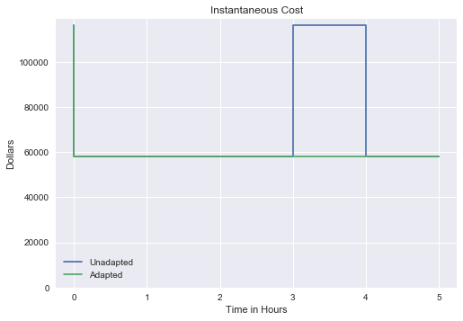
Cost Metric Instantaneous Cost
Unadapted - FT mission encountered a problem after t=3 which required landing and repeat the test again
Adapted - FT mission was accomplished successfully without having to land

Slide 9
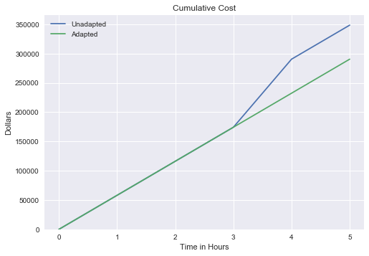
Cost Metric Cumulative Cost

Slide 10
Program Value Function
Maneuver value is the purpose of the flight test
Flight value is some value gained by having the plane in the air

Slide 11
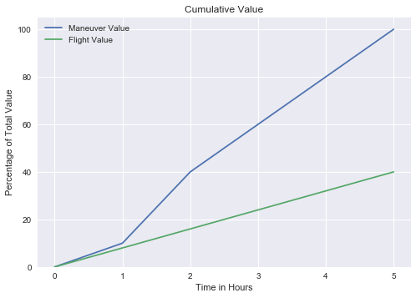
Program Value Function

Slide 12
Risk Metric
Measures the future uncertainties in achieving the test mission within the defined cost and schedule constraints
Risk Probability that a particular event will occur
Level | Value | Criteria
5 | Near certainty | Everything points to this becoming a problem
4 | Very likely | High chance of this becoming a problem
3 | Likely (50/50) | There is an even chance this may turn into a problem once in a while
2 | Unlikely | Risk like this may turn into a problem once in a while
1 | Improbable | Not much chance this will become a problem

Slide 13
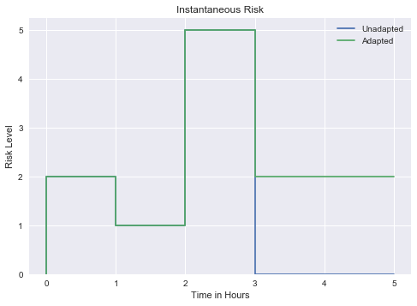
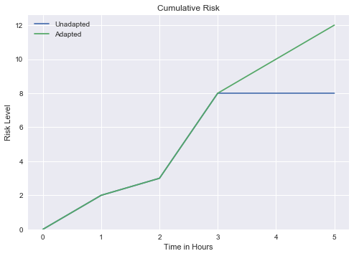
Risk Metric

Slide 14
Classic Solutions
Land and abort test
Increases cost of testing because we will have to start the test over
Impact flight test schedule
Stay in the air and perform other tests until the frequency is available
Assuming other tests can be performed while in flight
No MDL changes needed for both solutions

Slide 15
Suggested Solution
MDL Reconfiguration
<RadioLink> element is where most of the changes need to be done for both Radio (TA and Ground)
Describes a one-way connection two radio point
<TransmissionSchedule> element which describes the scheduling parameters for a static schedule
In this case we need to change the <CenterFrequencyHz> value to the new allocated frequency

Slide 16
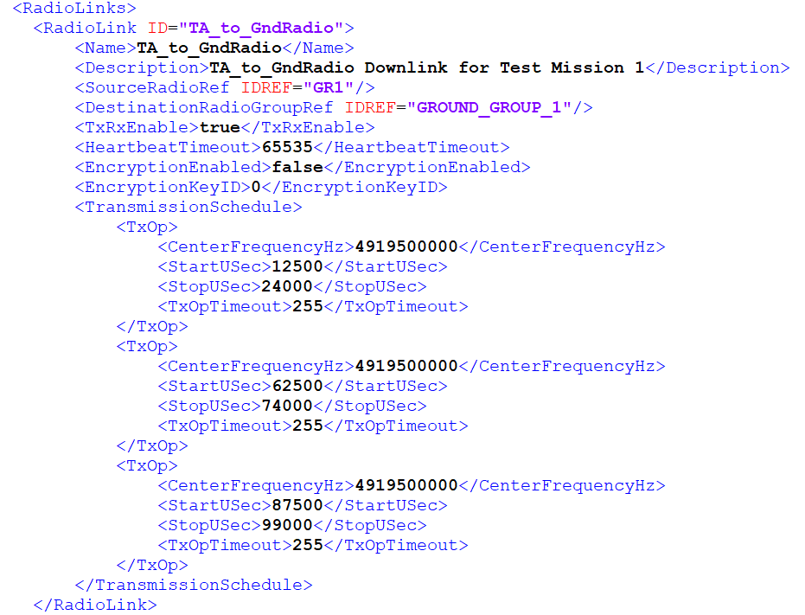
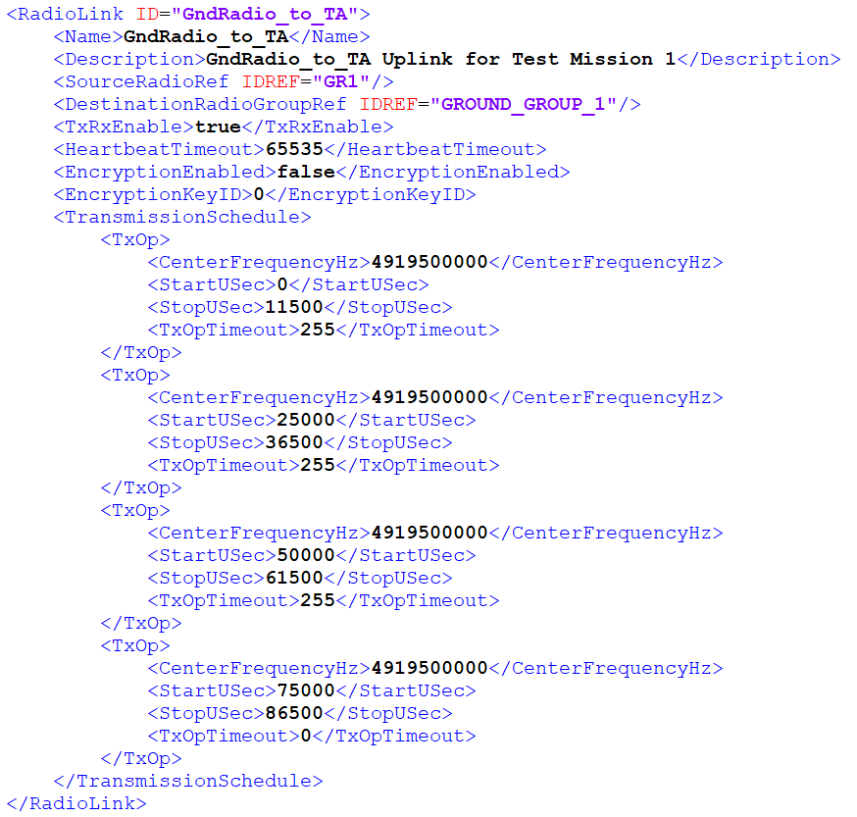
TA Radio MDL Configuration - Before
Ground Radio MDL Configuration – Before

Slide 17
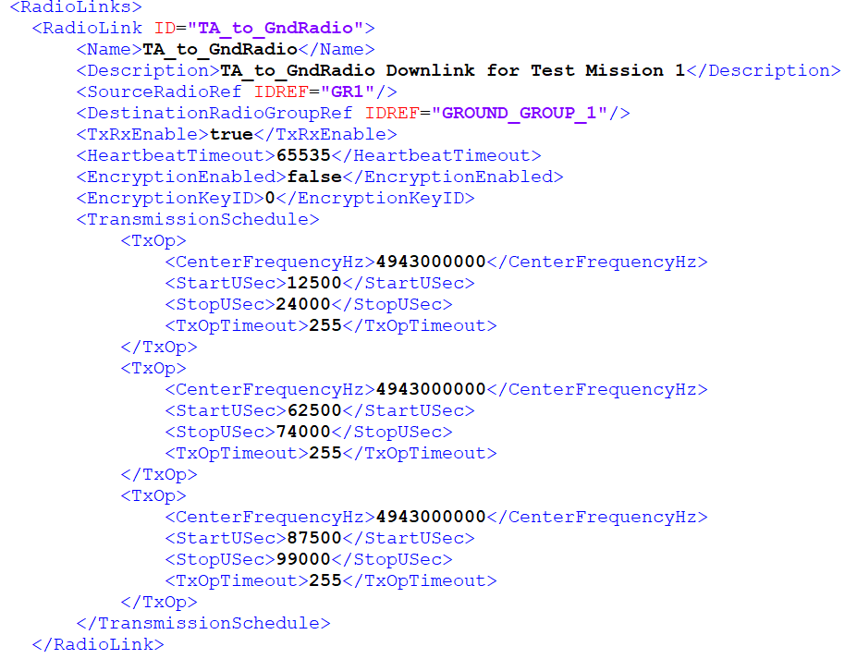
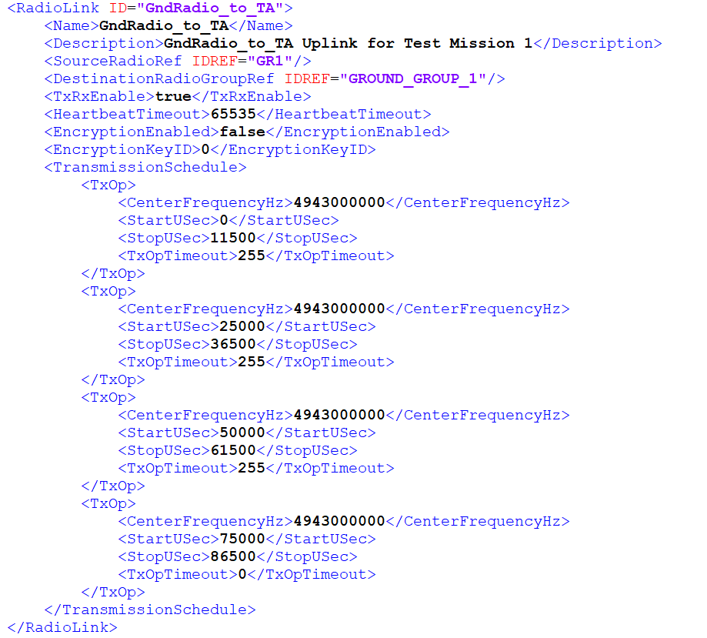
TA Radio MDL Configuration - After
Ground Radio MDL Configuration – After

Slide 18
sources
https://www.pmi.org/learning/library/project-management-cost-estimate-costs-5256
http://www.businessinsider.com/air-force-plane-cost-per-flight-hour-chart-2016-3
F22 and F35
http://nation.time.com/2013/04/02/costly-flight-hours/
https://www.rand.org/content/dam/rand/pubs/research_reports/RR1100/RR1178/RAND_RR1178.pdf
https://scout.com/military/warrior/Article/Air-Force-F-22-Conducts-Operational-Testing-of-New-Weapons-Tech-109177127

